Slide 1

Tutorial 1
Introduction to Basic Concepts
Tutor: Ting Zhang

Slide 2

Monday, 4:30 – 6:15 MB 2.285
Tutor:
Email:
Monday, 21:15 – 11:00 MB 1.301
Tutor: Ting Zhang
Email: ru_che@encs.concordia.ca
Tutorial web site:
http://users.encs.concordia.ca/~z_ting/comp5531/tutorial/

Slide 3

Start early as the workload of this course is fairly heavy;
Study smart as there are many tricks in this course;
Practice as much as possible, and you will find certain solution patterns existing in this course.

Slide 4

Definition 1
A database is a collection of data, typically describing the activities of one or more related organizations.
Definition 2
A database is a structured collection of records or data that is stored in a computer system.
And more ...
Databases have to be logically consistent and persistent.

Slide 5

Data in a database has to be organized according to certain data model.
The data model in most common use today is the relational model in which a database might contain information about the following:
  Entities (for example, students, faculty and courses)
  Relationships (for example, students enrolling in courses, faculty teaching courses)
  Most DBMS today are based on the relational data model.

Slide 6

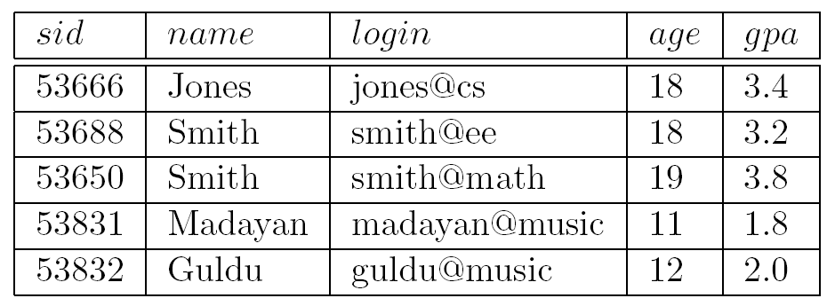
An instance of the Students relation

Slide 7

Schema: in the relational model, the schema for a relation specifies its name, the name of each field (also known as attribute or column), and the data type of each field.
An example:
Students(sid: string, name: string, gpa: real)
Schema name
Attribute name
Data type

Slide 8

In addition to the relational data model (which has been used in numerous systems, including IBM’s DB2, Oracle, Sybase, Access, MySQL), other important data models include:
  The hierarchical model
  The object-oriented model
  The object-relational model

Slide 9

A database management system, or DBMS, is software designed to assist in maintaining and utilizing large collections of data.
DBMS is among the most complicated types of software available. Why?

Slide 10

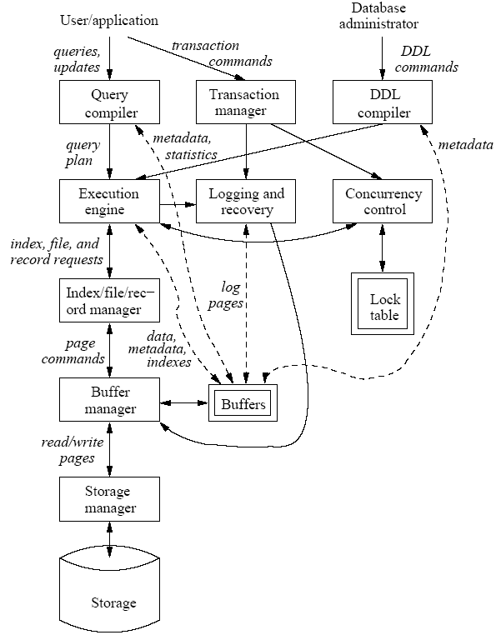
Each subsystem requires lots of work!

Slide 11

Allows users to create new databases and specify their schema (logical structure of the data), using a data-definition language (DDL).
Gives users the ability to query the data and modify the data, using a query language and data-manipulation language (DML).
Supports intelligent storage of very large amounts of data.
  Protects the data from accident or not proper use.
    Example: We can require from the DBMS to not allow the insertion of two different students with the same student ID.

Slide 12

  Allows efficient access to the data for queries and modifications.
    Example: The use of indexes over a specified field, e.g. on the name field for employees, allows fast response for queries asking a specific name.
Controls access to data from many users at once (concurrency), without allowing “bad” interactions that can corrupt the data accidentally.
Recovers from failures and crashes.

Slide 13

Indicate if the following statements are true or false:
1) A database is a collection of programs.
2) A database system is a collection of data.
3) A database system is a collection of data and programs that manage the data.
4) A DBMS is a collection of programs.

Slide 14

If we are dealing with a large collection of data, what’s the cons of storing data in operating system files?
  Main memory size Vs. disk size? We may not have enough main memory to hold all the data. We must therefore store data in a storage device, disk for example, and bring only relevant parts into main memory for processing as needed.
  Can it answer questions? In a file system, the only way to retrieve specific information is to search the “exact” plaintext.

Slide 15
  Consistency? We must protect the data from inconsistent changes made by different users accessing the data concurrently.
  Crash? We must ensure that data is restored to a consistent state if the system crashes while changes are being made.
  Security mechanism? Operating systems provide only a password mechanism for security. This is not sufficiently flexible to enforce security policies in which different users have permission to access different subsets of the data.

Slide 16
So correspondingly what are the advantages of a DBMS?
  Data Independence: the DBMS provides an abstract view of the data that hides the details of data representation and storage;
  Efficient Data Access
  Data Integrity and Security: the DBMS can enforce integrity constraints, and also it can enforce access controls that govern what data is visible to different classes of users;

Slide 17
  Data Administration (Centralization): experienced professionals, so-called DBA, can be responsible for organizing the data representation to minimize redundancy and for fine-tuning the storage of the data to make retrieval efficient;
  Concurrent Access and Crash Recovery
  Reduced Application Development Time: clearly, the DBMS supports important functions that are common to many applications accessing data in the DBMS (reuse).

Slide 18

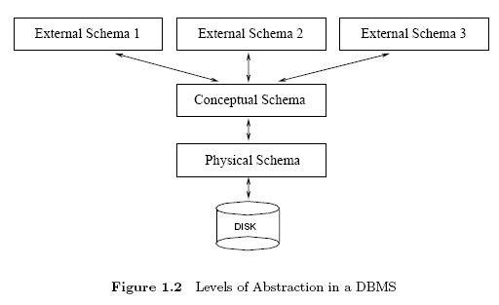
The data in a DBMS is described at three levels of abstraction.

Slide 19

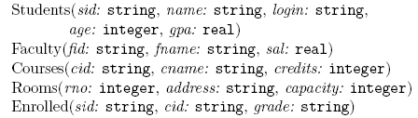
The conceptual schema (sometimes called the logical schema) describes the stored data in terms of the data model of the DBMS.
In a relational DBMS, the conceptual schema describes all relations.

Slide 20

The physical schema specifies additional storage details.
For example, how the relations described in the conceptual schema are actually stored on disks and/or tapes.
What file organizations to use to store the relations and create indexes?

Slide 21

External schemas, which usually are also in terms of the data model of the DBMS, allow data access to be customized at the level of individual users or groups of users, which result in the concept of “View”.
Any given database has exactly one conceptual schema and one physical schema, but it may have several external schemas.

Slide 22

How to design a database?
Capture User Requirements
Refine Schema
Draw E-R diagram
Convert E-R to Schema

Slide 23

How to utilize a database?
Relational Algebra
Relational Calculus
SQL

Slide 24

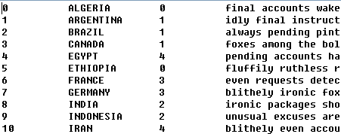
XML: the Extensible Markup Language (XML) is aimed at aiding information systems in sharing structured data, especially via the Internet.
Plain Text: usually in this case, each line represents a record and different fields are separated by space or comma.
  Example

Slide 25

DBMS is gaining increasing attention, but traditional data storage mechanisms are not dead. In fact, some of them are still very attractive, for example, Comma-Separated Values (CSV).
They are suitable for small businesses; they are faster than DBMS and free.
They are also suitable for early release of a software in which a database is needed (We can use CSV to substitute DBMS at the beginning to reduce the complexity).

Slide 26
The previous table can be converted as the CSV format as following:
sid, name, login, age, gpa
53666, Jones, jones@cs, 18, 3.4
53688, Smith, smith@ee, 18, 3.2
53650, Smith, smith@math, 19, 3.8

Slide 27


What’s a database?
What’s a DBMS?
What’s a data model?
What’s a relational data model?
Why DBMS?
Introduction to E-R Diagram

Slide 28

You may find this book quite useful:
Raghu Ramakrishman and Johannes Gehrke,
DATABASE MANAGEMENT SYSTEMS, third
edition, McGraw-Hill

